Slide 1
UNIT 3 Expert System

Slide 2
Expert Systems
Artificial Intelligence is a piece of software that simulates the behaviour and judgement of a human or an organization that has experts in a particular domain is known as an expert system.
It does this by acquiring relevant knowledge from its knowledge base and interpreting it according to the user’s problem.
The data in the knowledge base is added by humans that are expert in a particular domain and this software is used by a non-expert user to acquire some information. It is widely used in many areas such as medical diagnosis, accounting, coding, games etc.

Slide 3
An expert system is AI software that uses knowledge stored in a knowledge base to solve problems that would usually require a human expert thus preserving a human expert’s knowledge in its knowledge base.
They can advise users as well as provide explanations to them about how they reached a particular conclusion or advice. Knowledge Engineering is the term used to define the process of building an Expert System and its practitioners are called Knowledge Engineers.
The primary role of a knowledge engineer is to make sure that the computer possesses all the knowledge required to solve a problem.
The knowledge engineer must choose one or more forms in which to represent the required knowledge as a symbolic pattern in the memory of the computer.

Slide 4
Example : There are many examples of an expert system. Some of them are given below –
MYCIN –
One of the earliest expert systems based on backward chaining. It can identify various bacteria that can cause severe infections and can also recommend drugs based on the person’s weight.
DENDRAL –
It was an artificial intelligence-based expert system used for chemical analysis. It used a substance’s spectrographic data to predict its molecular structure.
R1/XCON –
It could select specific software to generate a computer system wished by the user.
PXDES –
It could easily determine the type and the degree of lung cancer in a patient based on the data.
CaDet –
It is a clinical support system that could identify cancer in its early stages in patients.
DXplain –
It was also a clinical support system that could suggest a variety of diseases based on the findings of the doctor.

Slide 5
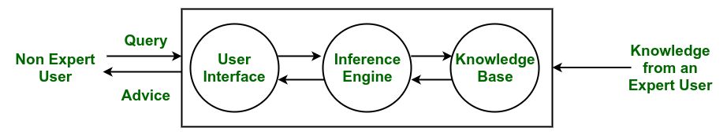
Components of an Expert System :

Slide 6
Knowledge Base –
The knowledge base represents facts and rules. It consists of knowledge in a particular domain as well as rules to solve a problem, procedures and intrinsic data relevant to the domain.
Inference Engine –
The function of the inference engine is to fetch the relevant knowledge from the knowledge base, interpret it and to find a solution relevant to the user’s problem. The inference engine acquires the rules from its knowledge base and applies them to the known facts to infer new facts. Inference engines can also include an explanation and debugging abilities.
Knowledge Acquisition and Learning Module –
The function of this component is to allow the expert system to acquire more and more knowledge from various sources and store it in the knowledge base.
User Interface –
This module makes it possible for a non-expert user to interact with the expert system and find a solution to the problem.
Explanation Module –
This module helps the expert system to give the user an explanation about how the expert system reached a particular conclusion.

Slide 7
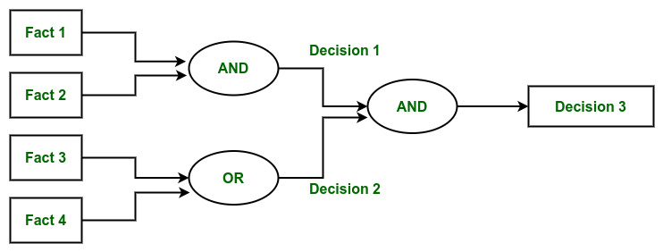
The Inference Engine generally uses two strategies for acquiring knowledge from the Knowledge Base, namely –
Forward Chaining
Backward Chaining
Forward Chaining –
Forward Chaining is a strategic process used by the Expert System to answer the questions – What will happen next. This strategy is mostly used for managing tasks like creating a conclusion, result or effect. Example – prediction or share market movement status.

Slide 8
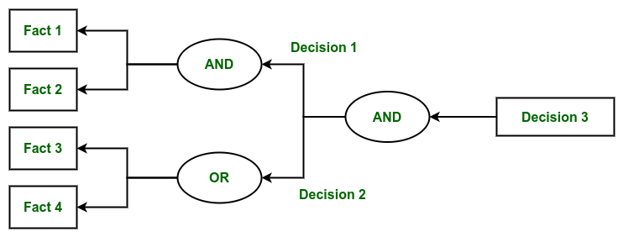
Backward Chaining –
Backward Chaining is a strategy used by the Expert System to answer the questions – Why this has happened. This strategy is mostly used to find out the root cause or reason behind it, considering what has already happened. Example – diagnosis of stomach pain, blood cancer or dengue, etc.

Slide 9
Characteristics of an Expert System :
Human experts are perishable, but an expert system is permanent.
It helps to distribute the expertise of a human.
One expert system may contain knowledge from more than one human experts thus making the solutions more efficient.
It decreases the cost of consulting an expert for various domains such as medical diagnosis.
They use a knowledge base and inference engine.
Expert systems can solve complex problems by deducing new facts through existing facts of knowledge, represented mostly as if-then rules rather than through conventional procedural code.
Expert systems were among the first truly successful forms of artificial intelligence (AI) software.

Slide 10
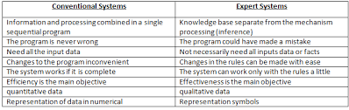

Slide 11
Advantages :
Low accessibility cost.
Fast response.
Not affected by emotions, unlike humans.
Low error rate.
Capable of explaining how they reached a solution.
Disadvantages :
The expert system has no emotions.
Common sense is the main issue of the expert system.
It is developed for a specific domain.
It needs to be updated manually. It does not learn itself.
Not capable to explain the logic behind the decision.

Slide 12
Applications :
The application of an expert system can be found in almost all areas of business or government. They include areas such as –
Different types of medical diagnosis like internal medicine, blood diseases and show on.
Diagnosis of the complex electronic and electromechanical system.
Diagnosis of a software development project.
Planning experiment in biology, chemistry and molecular genetics.
Forecasting crop damage.
Diagnosis of the diesel-electric locomotive system.
Identification of chemical compound structure.
Scheduling of customer order, computer resources and various manufacturing task.
Assessment of geologic structure from dip meter logs.
Assessment of space structure through satellite and robot.
The design of VLSI system.
Teaching students specialize task.
Assessment of log including civil case evaluation, product liability etc.

